Slide 1
Inter-Cloud Collaboration in Arrowhead -- Gatekeepers, Gateways, Brokers --
Csaba Hegedűs (hegeduscs@aitia.ai)
Pál Varga (pvarga@tmit.bme.hu)
Nikolett Szeles
Zoltán Umlauf
AITIA Inc.
Budapest University of Technology

Slide 2
Agenda
Short recap on inter-Cloud orchestration and servicing
Data path realization
Gateway
Arrowhead Brokers
A use case scenario
Further, full implementation details

Slide 3
Primary scenario

Slide 4
Inter-Cloud servicing
Fundaments:
Local Clouds are autonomous and independent from each another
Within an LC ther can be decentralized governance (minimal Core System functionality) or strict centralization -- from the outside, we don’t care!
But inter-Cloud requires that there are central entities responsible for:
security: admission control (letting in external Systems)→AAA!
creation of the data path inbetween Clouds (if needed)
App. Systems should not be aware if partner is from another cloud
Therefore:
During inter-Cloud orchestration, the 2 sets of Core Systems are negotiating.
It is completely transparent for App. Systems
Technical analogy: roaming in telecommunication

Slide 5
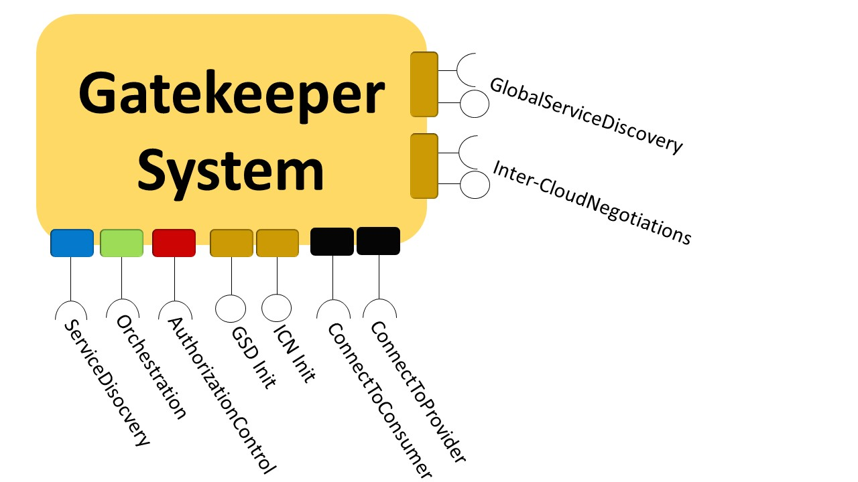
Two Supporting Core Systems
Gatekeeper
Active on the control plane, part of orchestration
Commanded by its own Orchestrator
Utilizes other Core Systems: Service Registry, Orchestrator, Authorization and Gateway
Interacts with other Gatekeepers
Always visible from the outside
Gateway
A network tunnel between the local network and the outside
Actively participates in the inter-Cloud data path
Not always visible from the outside, just on demand

Slide 6
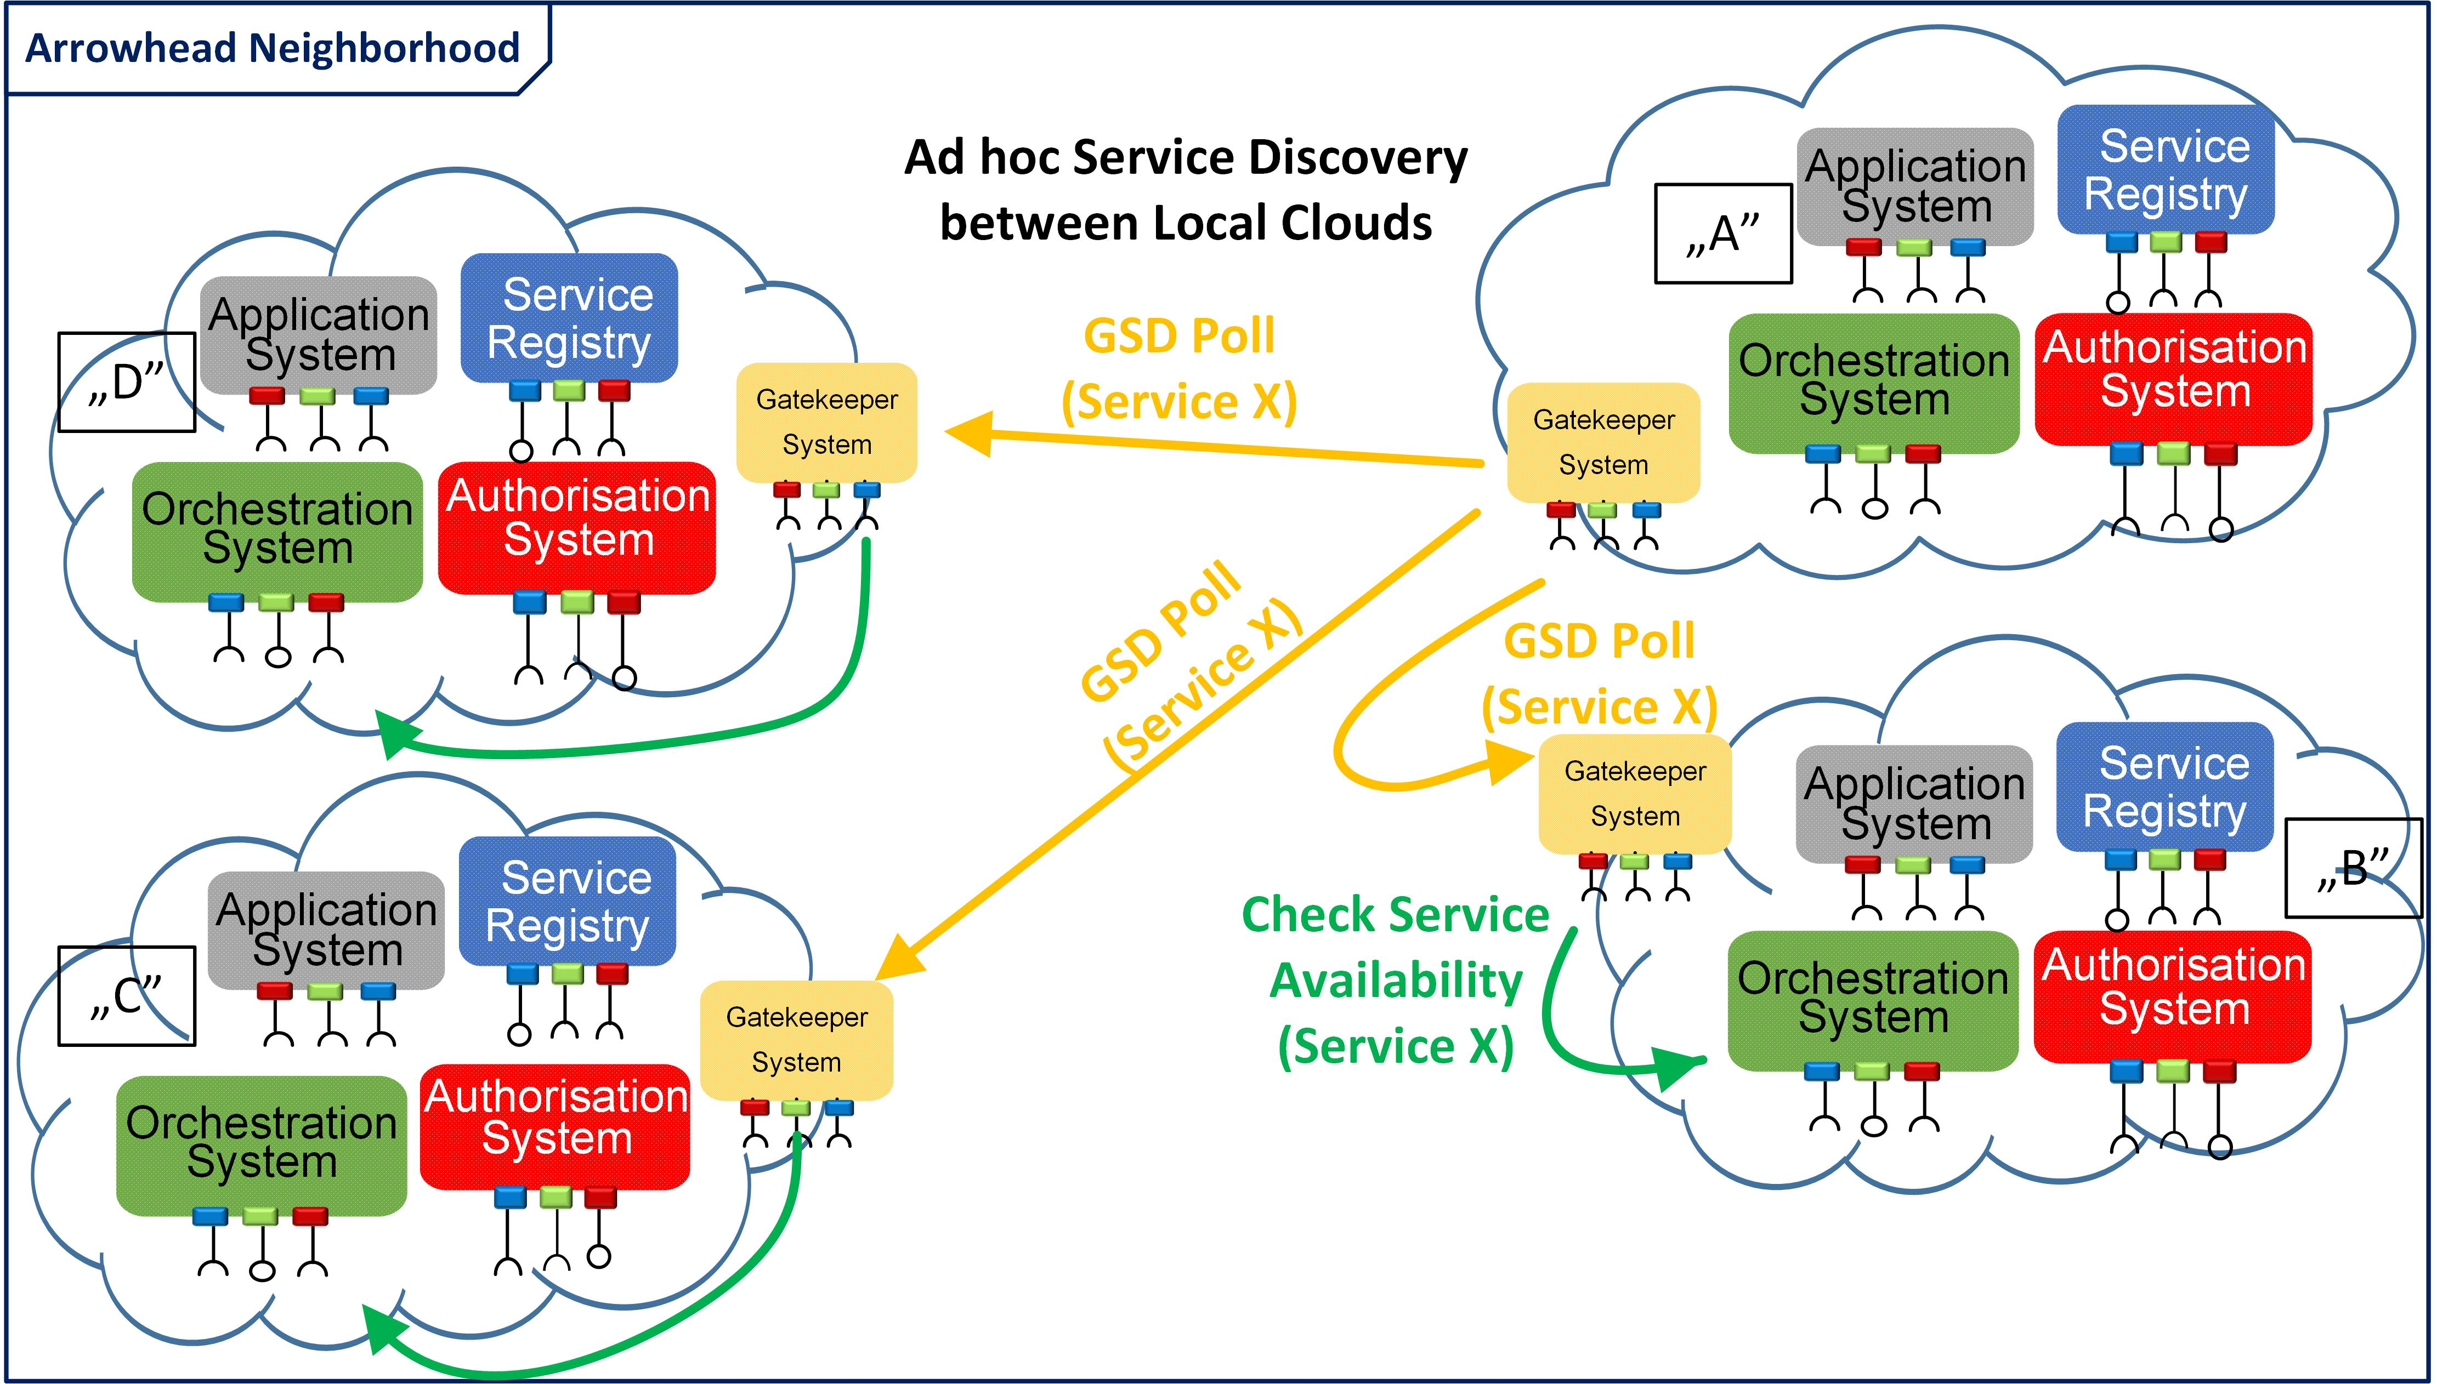
The Gatekeeper Services
Global Service Discovery (GSD)
Initiated by the Orchestrator of the original LC
To locate other Clouds where the service is currently available for us
Inter-Cloud Negotations (ICN)
There is a distinct intention between the two LC-s that the servicing shall happen.
This Service (process) starts preparing the session and negotiating the terms between the two LC-s.
Setting up the data path

Slide 7
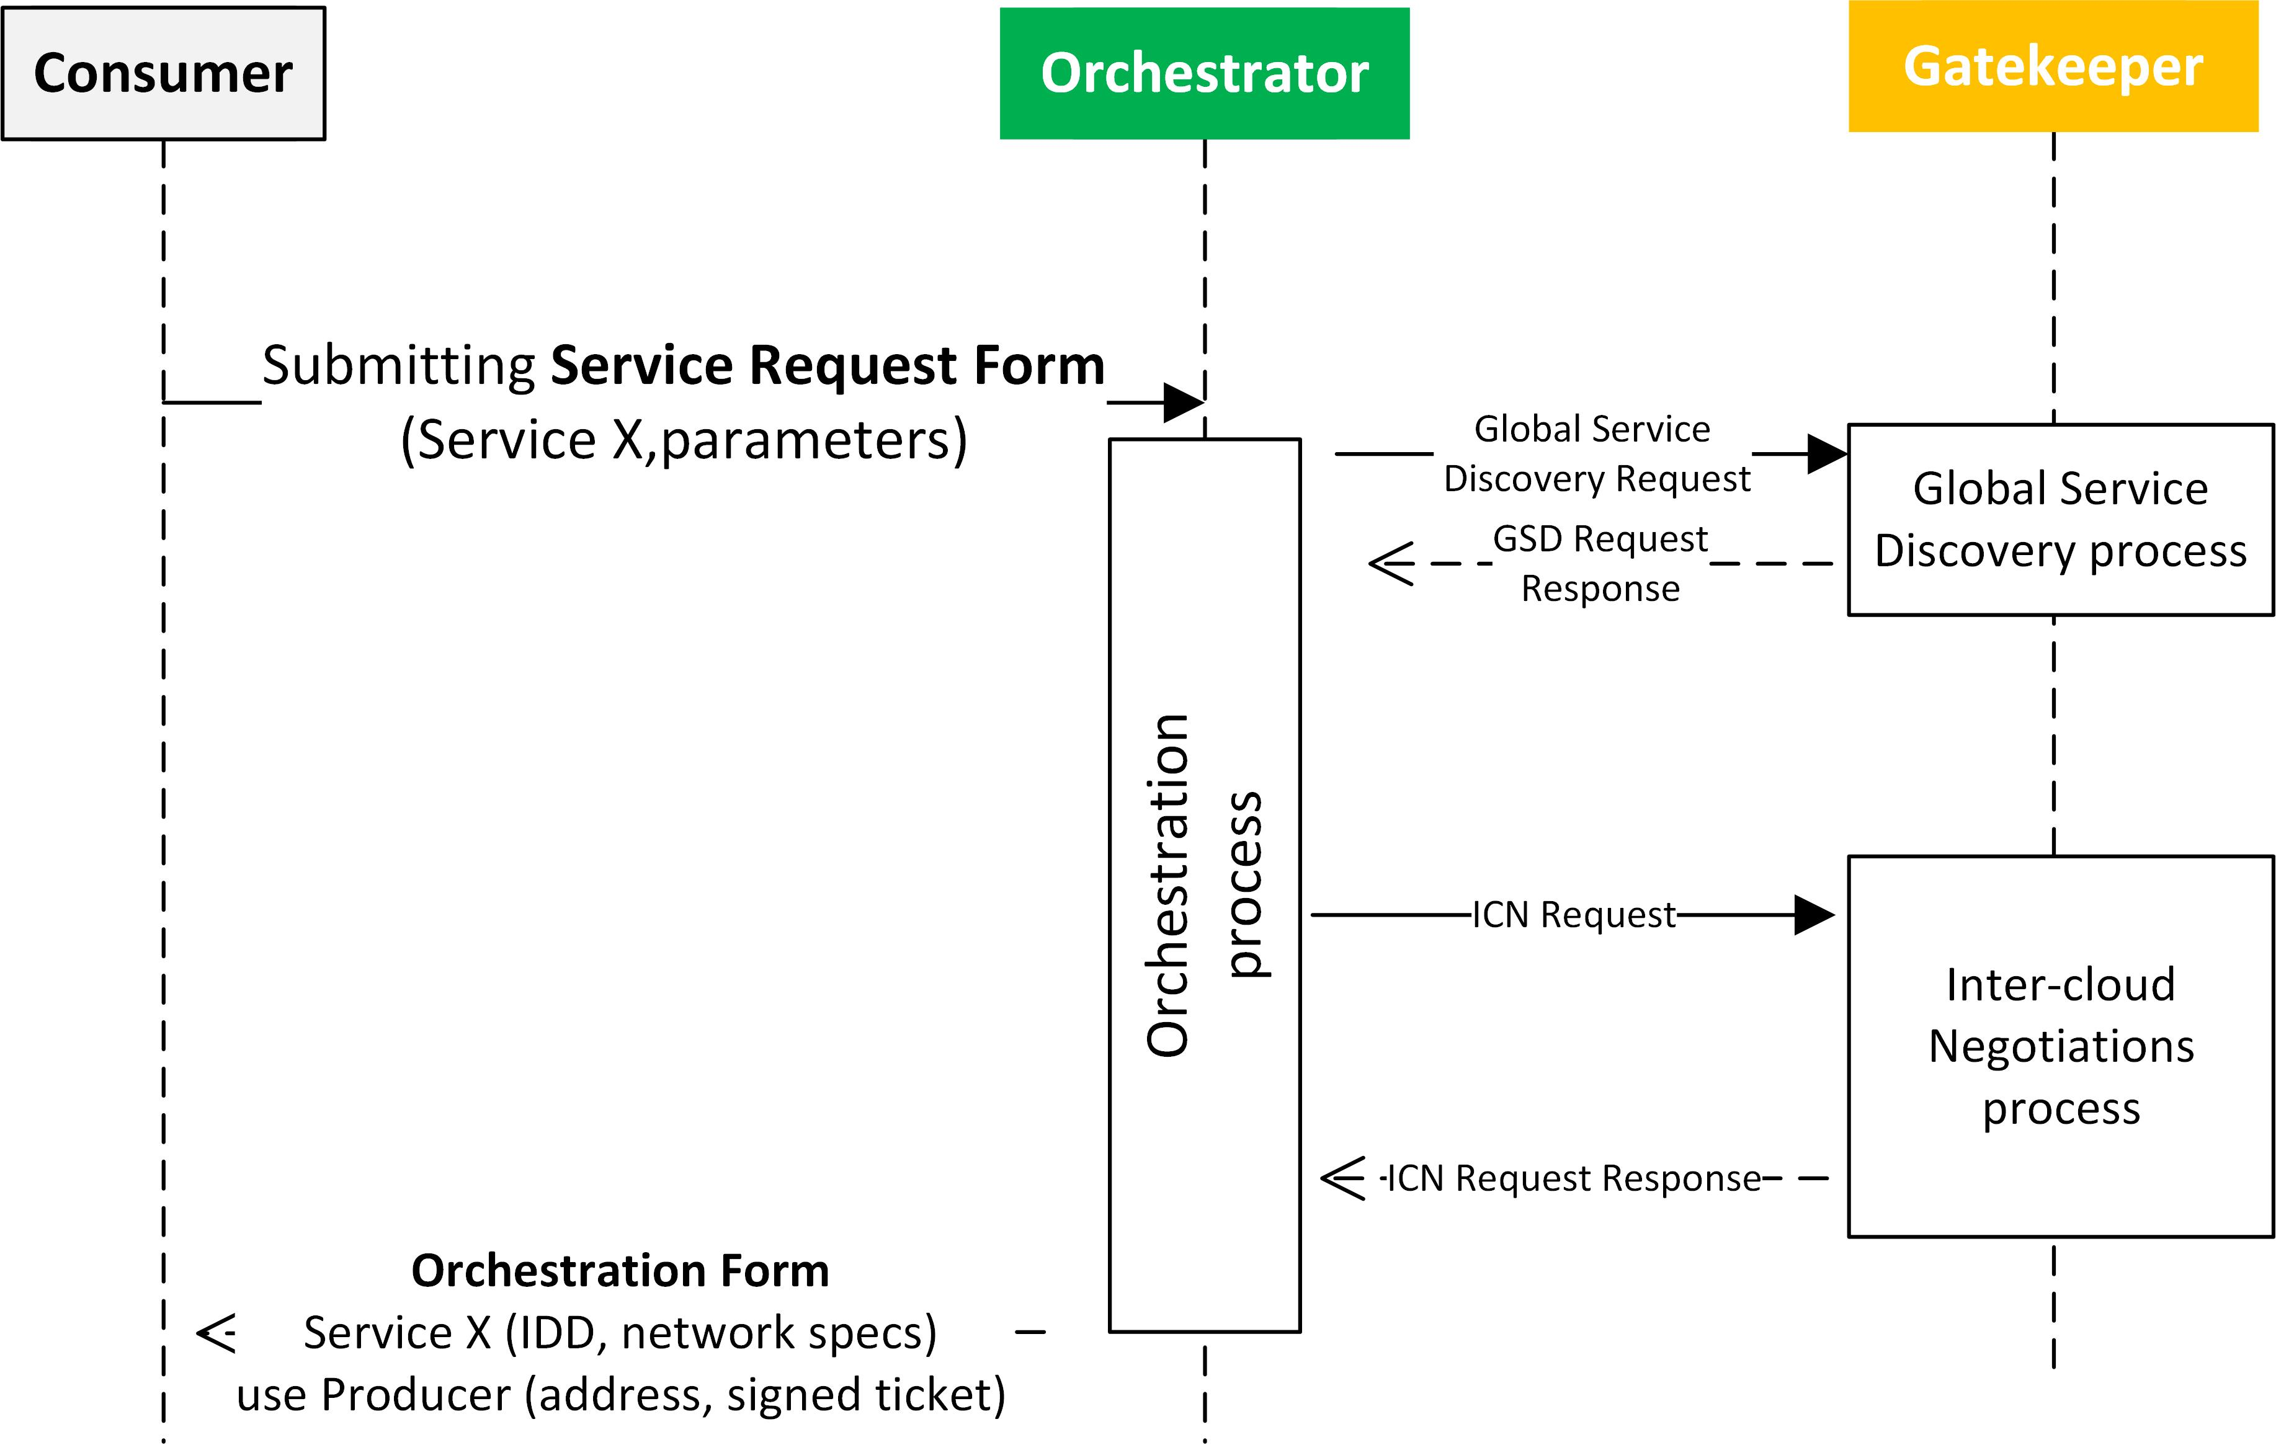
Inter-Cloud orchestration process (from the inside)

Slide 8
Arrowhead Inter-Cloud architectures
How to realize the Global Service Discovery functionality?
Which (other) Local Clouds do we ask when GSD?
How do we know them („discover the neighborhood”)?
We proposed three architectures:
Completely closed Arrowhead Neighborhoods
(Production plants)
Peer-to-peer ad hoc detection of other Local Clouds
(moving cars along the road, looking up local infrastructure)
A cloud-of-clouds entity handling the interactions between Local Clouds
(integration along the supply chain)
(supply and demand)

Slide 9
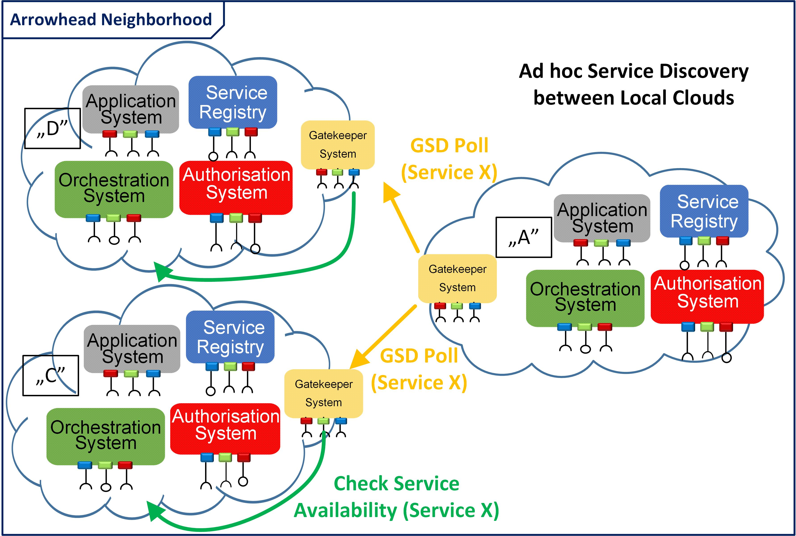
Closed Neighborhoods (G3.2 M3)

Slide 10
Network visibility issues
Previously we assumed that the LC-s share a common address space: only the Gatekeeper has been implemented.
We assumed that the Provider and Consumer can address each other, even if they logically belong to two separate LC-s (i.e. governed by two sets of Core System instances)
We just needed to orchestrate them to „to get together”
However, LC-s are intended to be closed, segregated networks.
Security is provided by:
Physical segregation (no connection outwards)
Network segregation (network behind firewall and/or NAT)
Arrowhead runtime certificate hierarchy and access control mechanisms
Now we are going to assume that:
An LC is behind firewall and symmetrical NAT
A specific Core System is to act as a gateway towards the outside world.

Slide 11
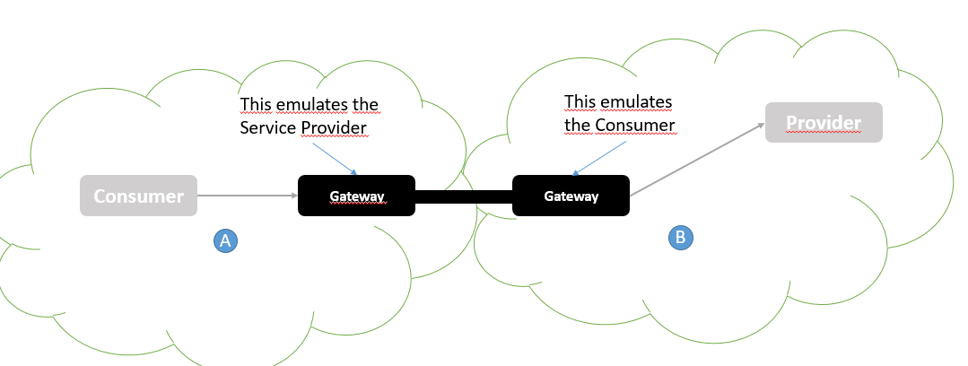
Gateway: Data path realizations between Clouds
TCP tunneling service between Consumer and Provider
The Gateway is configured by its own Gatekeeper at the end of the inter-Cloud Negotiations process.
Awaiting the connection from the Consumer, and forwarding it to the Provider (and vice versa)

Slide 12

Arrowhead Brokers / Relays
This tunneling is implemented using RabbitMQ brokers and AMQP protocol.
RabbitMQ Broker
Local Cloud „A”
Local Cloud „B”
2
3
7
6
Authorisation
Gateway
Gateway
Authorisation
4
Orchestration
5
1
8
Service Registry
Provider
Service Registry
Gatekeeper
Gatekeeper
Consumer
Orchestration

Slide 13
Arrowhead Brokers / Relays
The brokers are acting as relays.
Advantages:
LC-s and therefore Gateways can reside behind symmetrical NATand firewalls: they are starting the connection towards the broker.
The connection to the broker is on demand, only needed when there is an active inter-Cloud service connection.
The brokers are part of the Arrowhead architecture, have their own Arrowhead runtime certificate → chain of trust is maintainted.
No single point of failure: broker cluster, load balancing, re-routing in case of failure (provided by AMQP).
Disadvantages:
Brokers are needed, and they have to be Arrowhead-compliantly set up

Slide 14
Gateway Services in short
ConnectToProvider (Provider-side LC)
Generates topic name and end-to-end encryption keys for the session
Awaits message from Broker, sends to the Provider
Sends back the response from the Provider
Closes the socket to the Provider, if the remote Consumer or the Provider closes the socket.
ConnectToConsumer
Assigns a local port and starts waiting for the Consumer to establish the socket.
If the Consumer is connecting, verifies the identity, and sends the inbound data to the Broker.
If the broker sends data back (from the other LC), then forwards this to the Consumer.
Closes the socket towards the Consumer, if the Consumer or the Provider closes the connection.

Slide 15
Overview on the inter-Cloud orchestration process
1: Service Request
2: GSD and then ICN Init
3: ICN Proposal
4: Service Request (remote)
5: ConnectToProvider
6: ICN Response
7: ConnectToConsumer
8: Orchestration Response
9: Application Service Call
10-11: TCP tunneling
12: Application Service Call

Slide 16
Security mechanisms -- summary
The Gatekeepers are the only always visible entities from the outside, but cannot access App. Systems directly.
Gateways can access App. Systems, but they are only activated and exposed if ICN was successful. Otherwise, they are not connected to the outside world.
Gateway- Broker connection is encrypted (TLS, Arrowhead certificates)
Gateway-to-Gateway encryption over AMQP (payload encryption)
End-to-end encyption: Consumer - Provider
Arrowhead’s chain of trust model is fully maintained. (see AAA_in_Arrowhead_M2 presentation)
Inter-Cloud Negotiations (ICN) happen over a trusted and verified channel (TLS secured, using Arrowhead’s chain of trust model)
Authorization token is integrated in the process: access control is maintained.
If needed, the decyrpted data traffic can be monitored even at the Gateway: payload inspection (App. Services can be filtered not to send out unwanted data)
Full accountability: App. Systems can only access Services via the Core Systems, and they are logging.

Slide 17
?
Thank you!

Slide 18
Full implementation details

Slide 19
Will be elaborated separately.

